Slide 1
Wireless Sensor Network In Environment Monitoring
SlideMake.com

Slide 2
Introduction to Wireless Sensor Network in Environment Monitoring
Wireless sensor networks (WSNs) are networks of small devices equipped with sensors that collect and transmit data wirelessly.
WSNs are widely used in environmental monitoring to gather data on various parameters such as temperature, humidity, air quality, and water quality.
The use of WSNs in environment monitoring enables real-time data collection, analysis, and decision-making for effective resource management and conservation.
1
Notes:
Image source: https://www.researchgate.net/figure/The-general-architecture-of-Wireless-Sensor-Networks-WSNs-Sensor-Nodes-Sink-Nodes-a_fig1_344701127

Slide 3
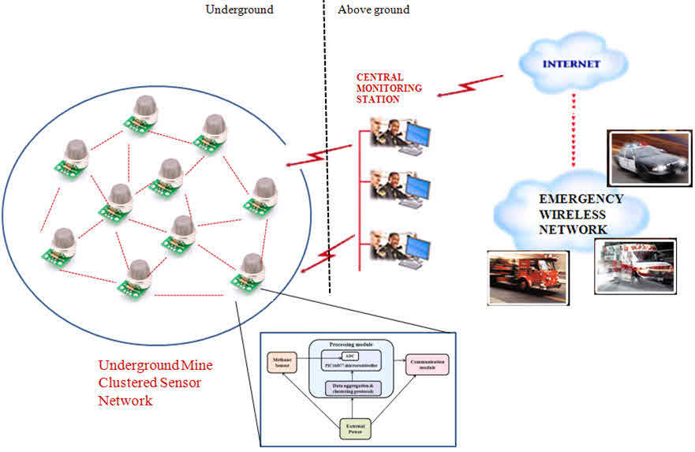
Key Components of a Wireless Sensor Network
Sensor nodes: Small devices equipped with sensors to collect data.
Wireless communication: Nodes transmit data wirelessly to a central hub or base station.
Data processing and analysis: Collected data is processed and analyzed to extract meaningful information.
2
Notes:
Image source: https://amazonia.fiocruz.br/scdp/essay/writing-practice-test-online/wireless-sensor-networks-are-different-from-other.php

Slide 4
Advantages of Wireless Sensor Network
Cost-effective: WSNs offer a cost-effective solution compared to traditional wired monitoring systems.
Scalability: WSNs can be easily scaled up or down by adding or removing sensor nodes as required.
Real-time monitoring: WSNs enable real-time data collection and monitoring, allowing for quick response and decision-making.
3
Notes:
Image source: https://www.researchgate.net/figure/Wireless-sensor-network-architecture_fig1_276306398

Slide 5
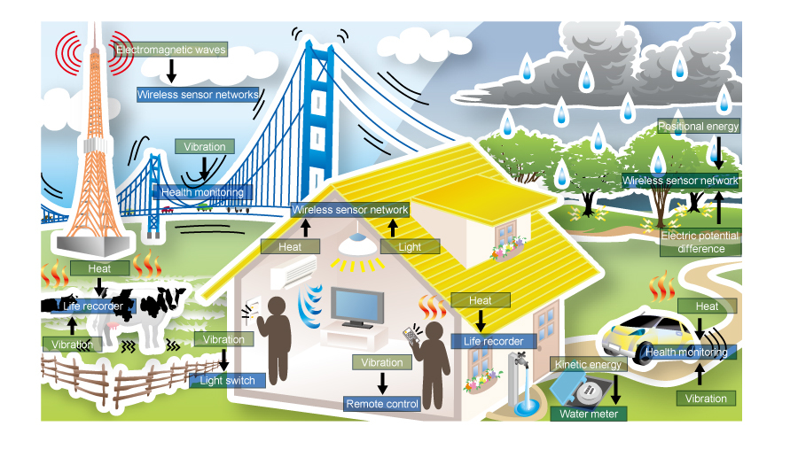
Applications of Wireless Sensor Network in Environment Monitoring
Air quality monitoring: WSNs can collect data on pollutants, temperature, and humidity levels to assess air quality in real-time.
Water quality monitoring: WSNs can monitor parameters such as pH, turbidity, and dissolved oxygen levels in bodies of water to ensure water quality.
Forest fire detection: WSNs can detect changes in temperature and humidity to identify potential forest fire hazards.
4
Notes:
Image source: https://microcontrollerslab.com/wireless-sensor-networks-wsn-applications/

Slide 6
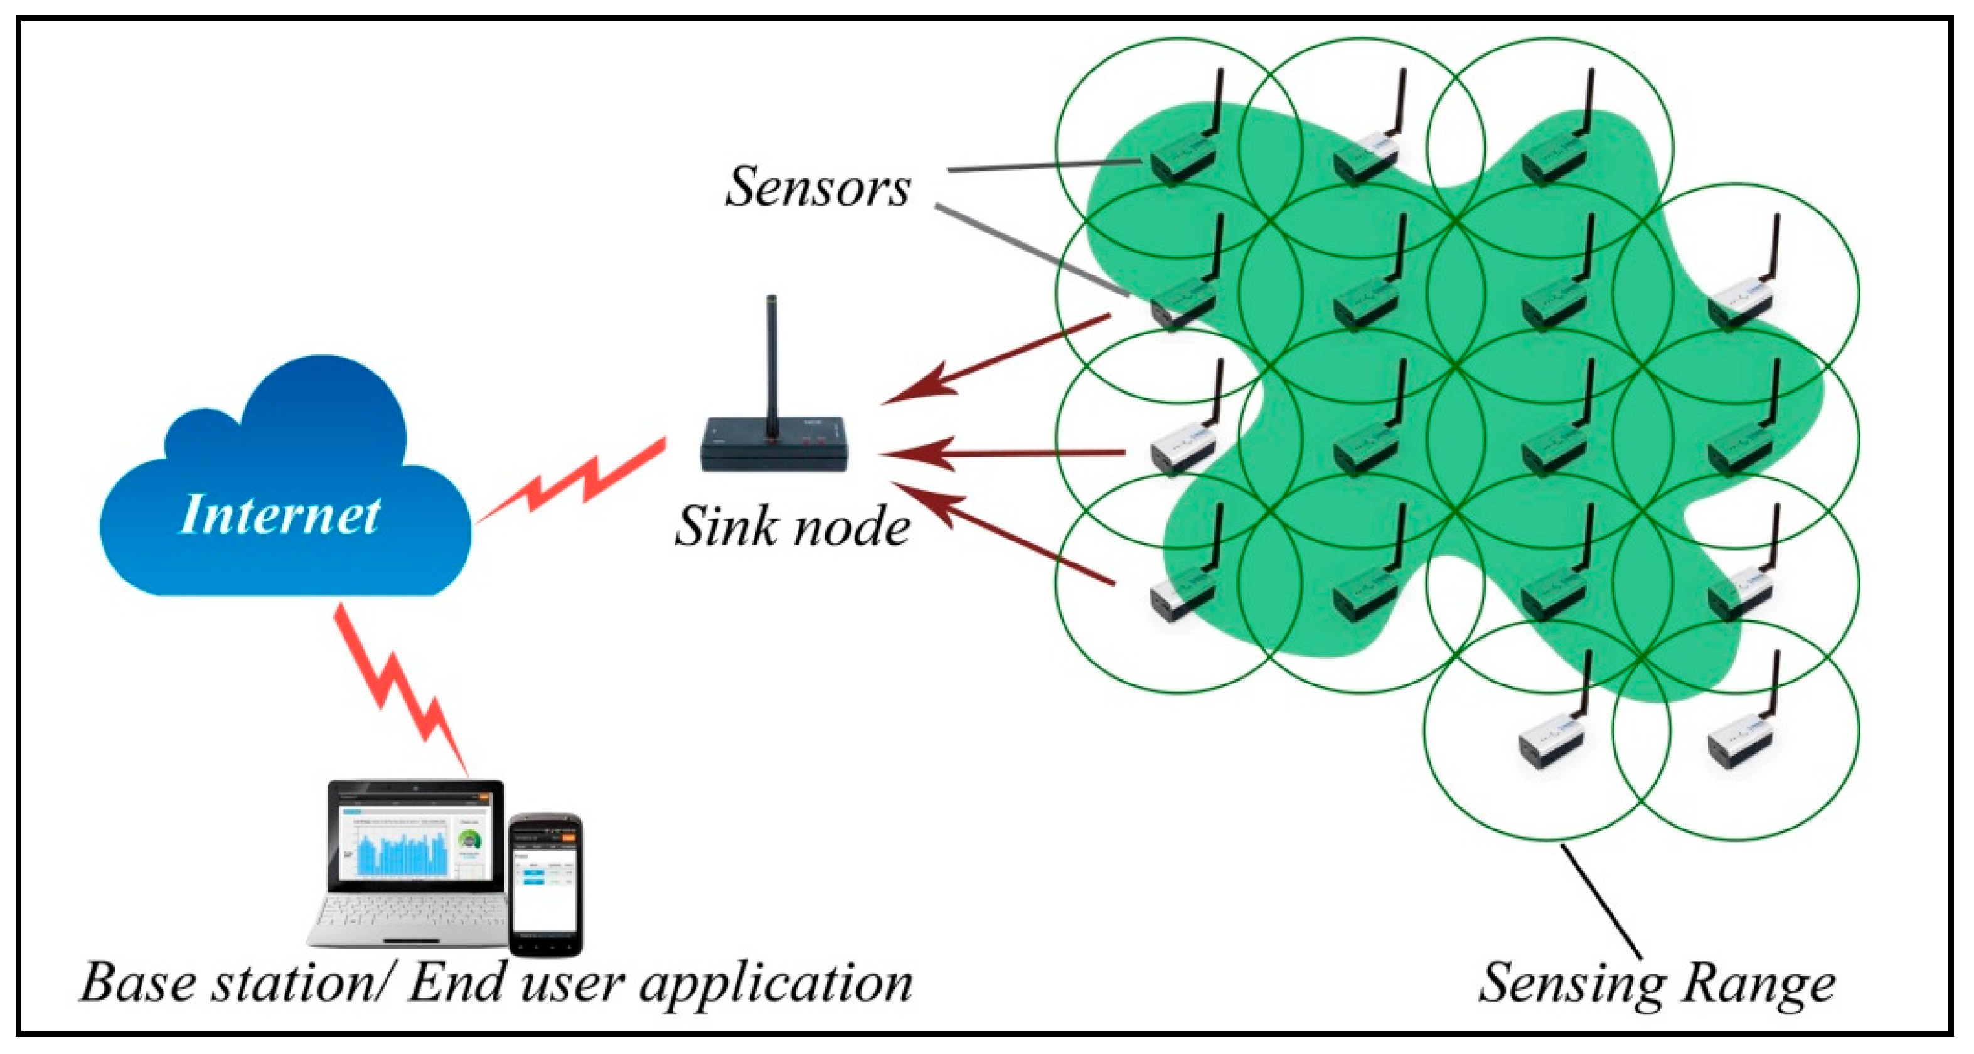
Challenges in Wireless Sensor Network Deployment
Energy efficiency: Sensor nodes have limited battery life, and energy-efficient protocols are required to prolong their operation.
Data security: Wireless transmission of data can be vulnerable to interception and tampering, necessitating robust security measures.
Network coverage: WSNs may require a large number of sensor nodes to ensure adequate coverage, which can be challenging in remote or inaccessible areas.
5
Notes:
Image source: http://www.mdpi.com/1999-4893/10/3/80

Slide 7
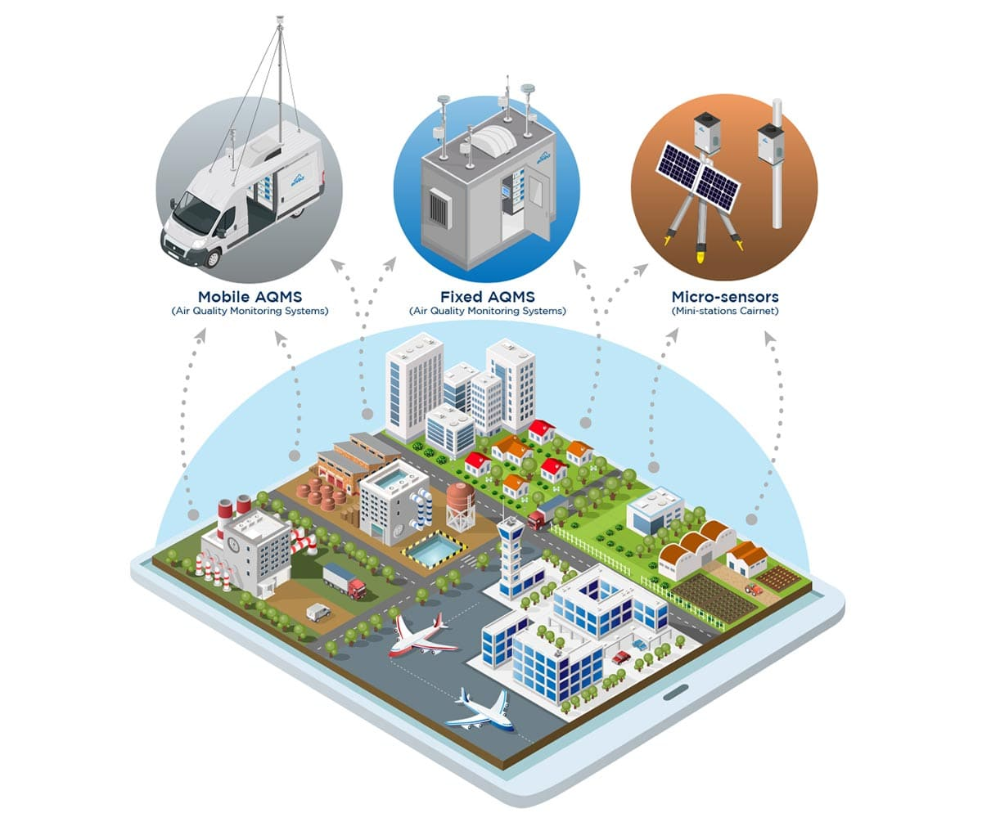
Case Study: Environmental Monitoring using Wireless Sensor Network
Example: Monitoring air quality in a city using a WSN.
Sensor nodes placed strategically in various locations to collect data on air pollutants, temperature, and humidity.
Data transmitted wirelessly to a central hub for analysis and visualization.
6
Notes:
Image source: https://www.envea.global/solutions/ambient-monitoring/air-quality-monitoring/

Slide 8
Benefits of Wireless Sensor Network in Environmental Monitoring
Early warning systems: Real-time data collection and analysis enable the development of early warning systems for environmental hazards.
Remote monitoring: WSNs allow for remote monitoring of inaccessible or hazardous areas, reducing the risk to human operators.
Data-driven decision-making: Accurate and real-time data provided by WSNs facilitates better decision-making for environmental management.
7
Notes:
Image source: https://microcontrollerslab.com/wireless-sensor-networks-wsn-applications/

Slide 9
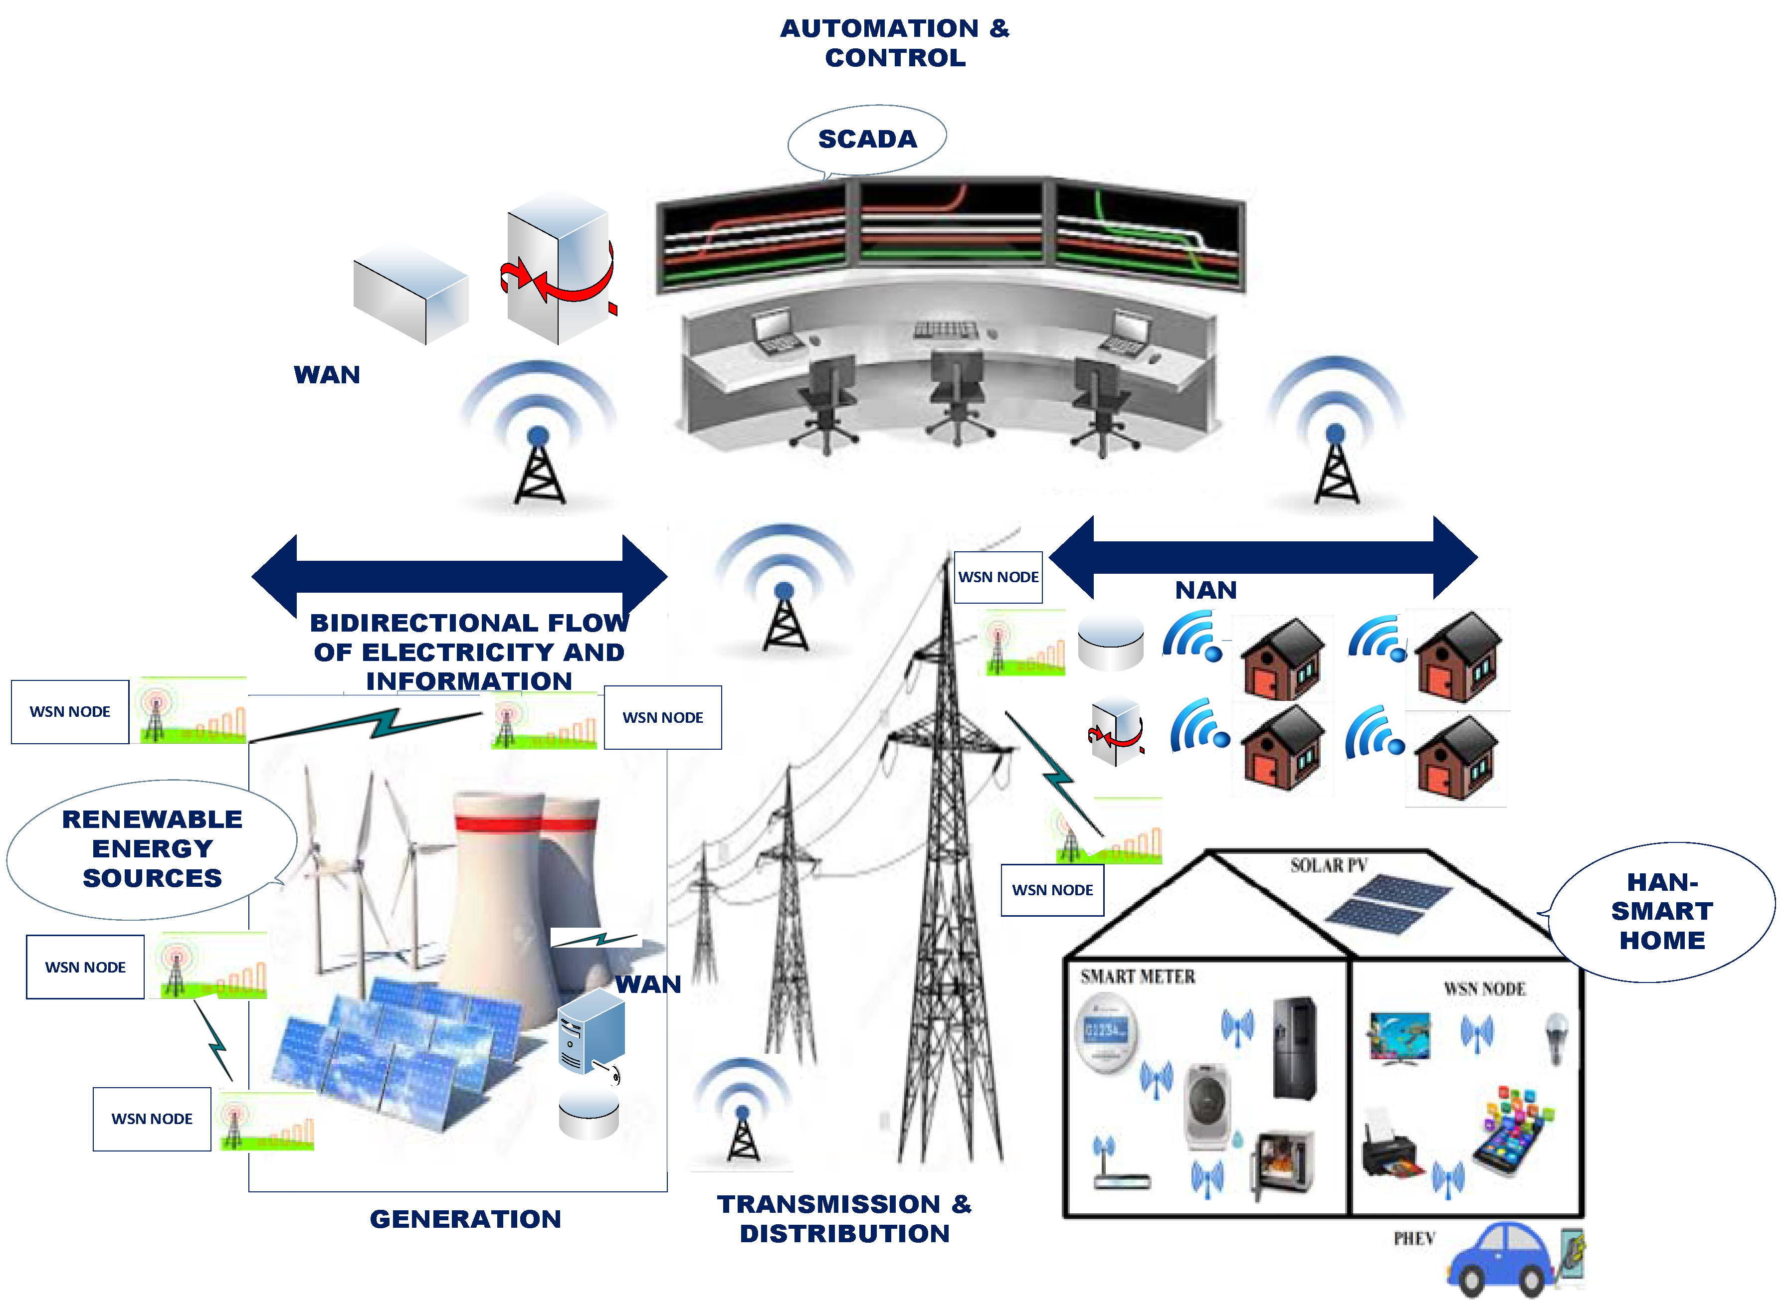
Future Trends in Wireless Sensor Network
Integration with IoT: WSNs can be integrated with the Internet of Things (IoT) to enable seamless connectivity and data sharing.
Autonomous sensor nodes: Development of autonomous sensor nodes with energy harvesting capabilities to overcome battery limitations.
Machine learning and AI: Utilizing machine learning and artificial intelligence techniques for advanced data analysis and predictive modeling.
8
Notes:
Image source: http://www.mdpi.com/2079-9292/6/1/5

Slide 10
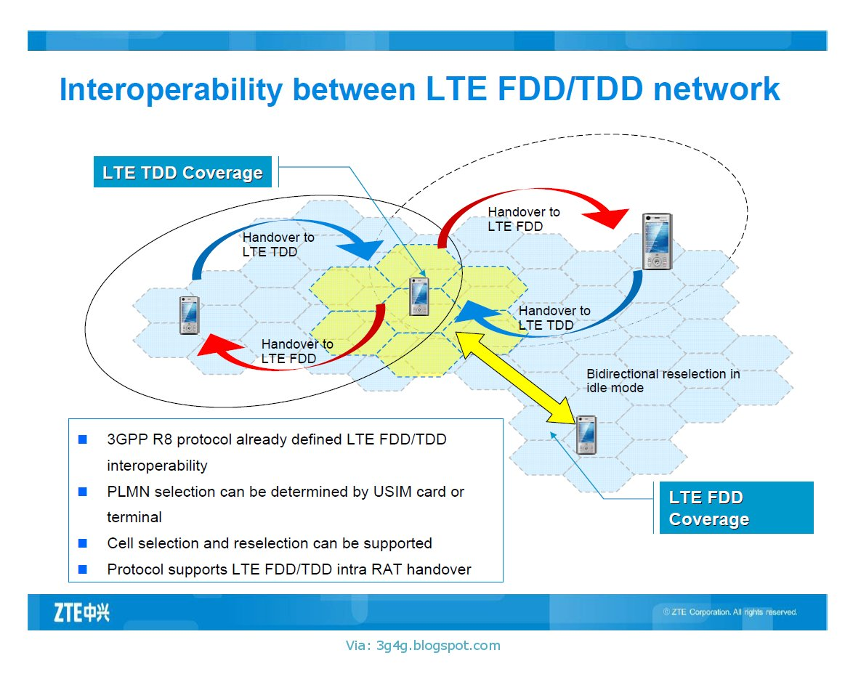
Challenges and Future Directions
Interoperability: Standardization and interoperability between different WSN platforms and protocols are essential for seamless integration.
Data management: Handling and analyzing the vast amounts of data generated by WSNs pose challenges for storage, processing, and interpretation.
Environmental impact: Considerations regarding the environmental impact of WSN deployment, including e-waste management and energy consumption.
9
Notes:
Image source: http://3g4g.blogspot.com/2011/11/interoperability-between-lte-fddtdd.html

Slide 11
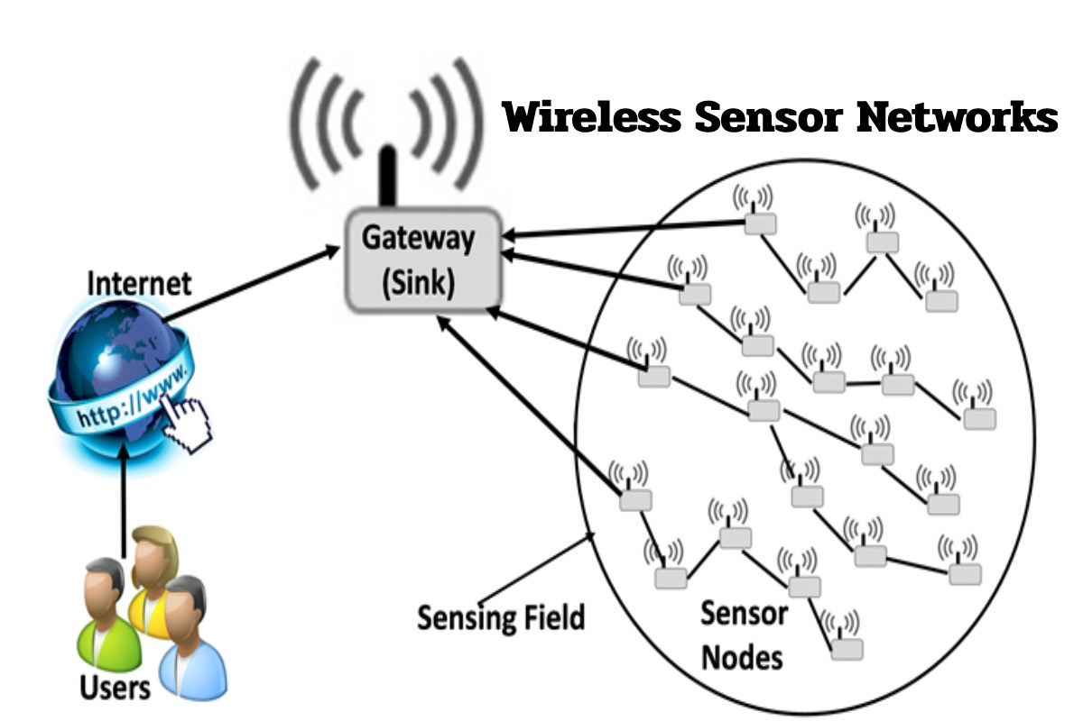
Conclusion
Wireless sensor networks play a crucial role in environment monitoring, enabling real-time data collection, analysis, and decision-making.
Despite challenges, WSNs offer numerous advantages such as cost-effectiveness, scalability, and remote monitoring capabilities.
The integration of WSNs with emerging technologies and continued research will further enhance their effectiveness in environmental monitoring.
10
Notes:
Image source: https://www.technologyify.com/wireless-sensor-networks/

Slide 12
References
Akyildiz, I. F., et al. (2002). Wireless sensor networks: a survey. Computer Networks, 38(4), 393-422.
Li, D., et al. (2019). Wireless Sensor Networks for Environmental Monitoring: A Review. Sensors, 19(6), 1371.
Szczechowiak, P., et al. (2017). Wireless sensor networks for environmental monitoring. In 2017 Federated Conference on Computer Science and Information Systems (FedCSIS) (pp. 377-384). IEEE.
11

